Slide 1
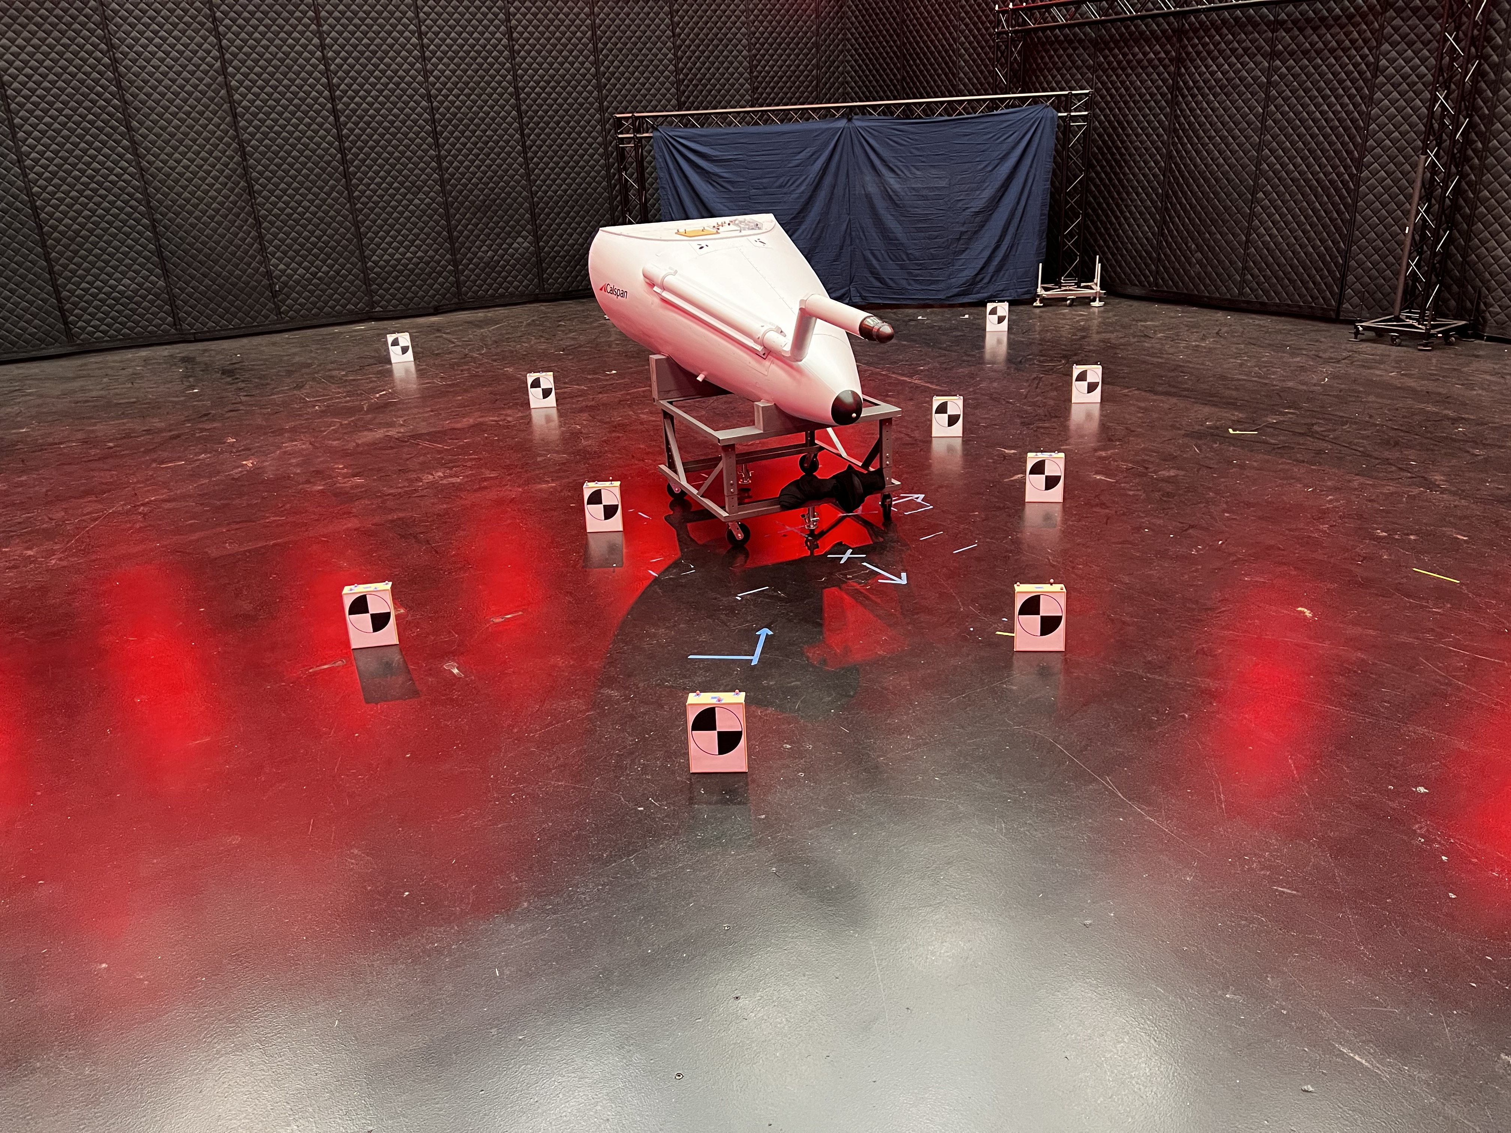

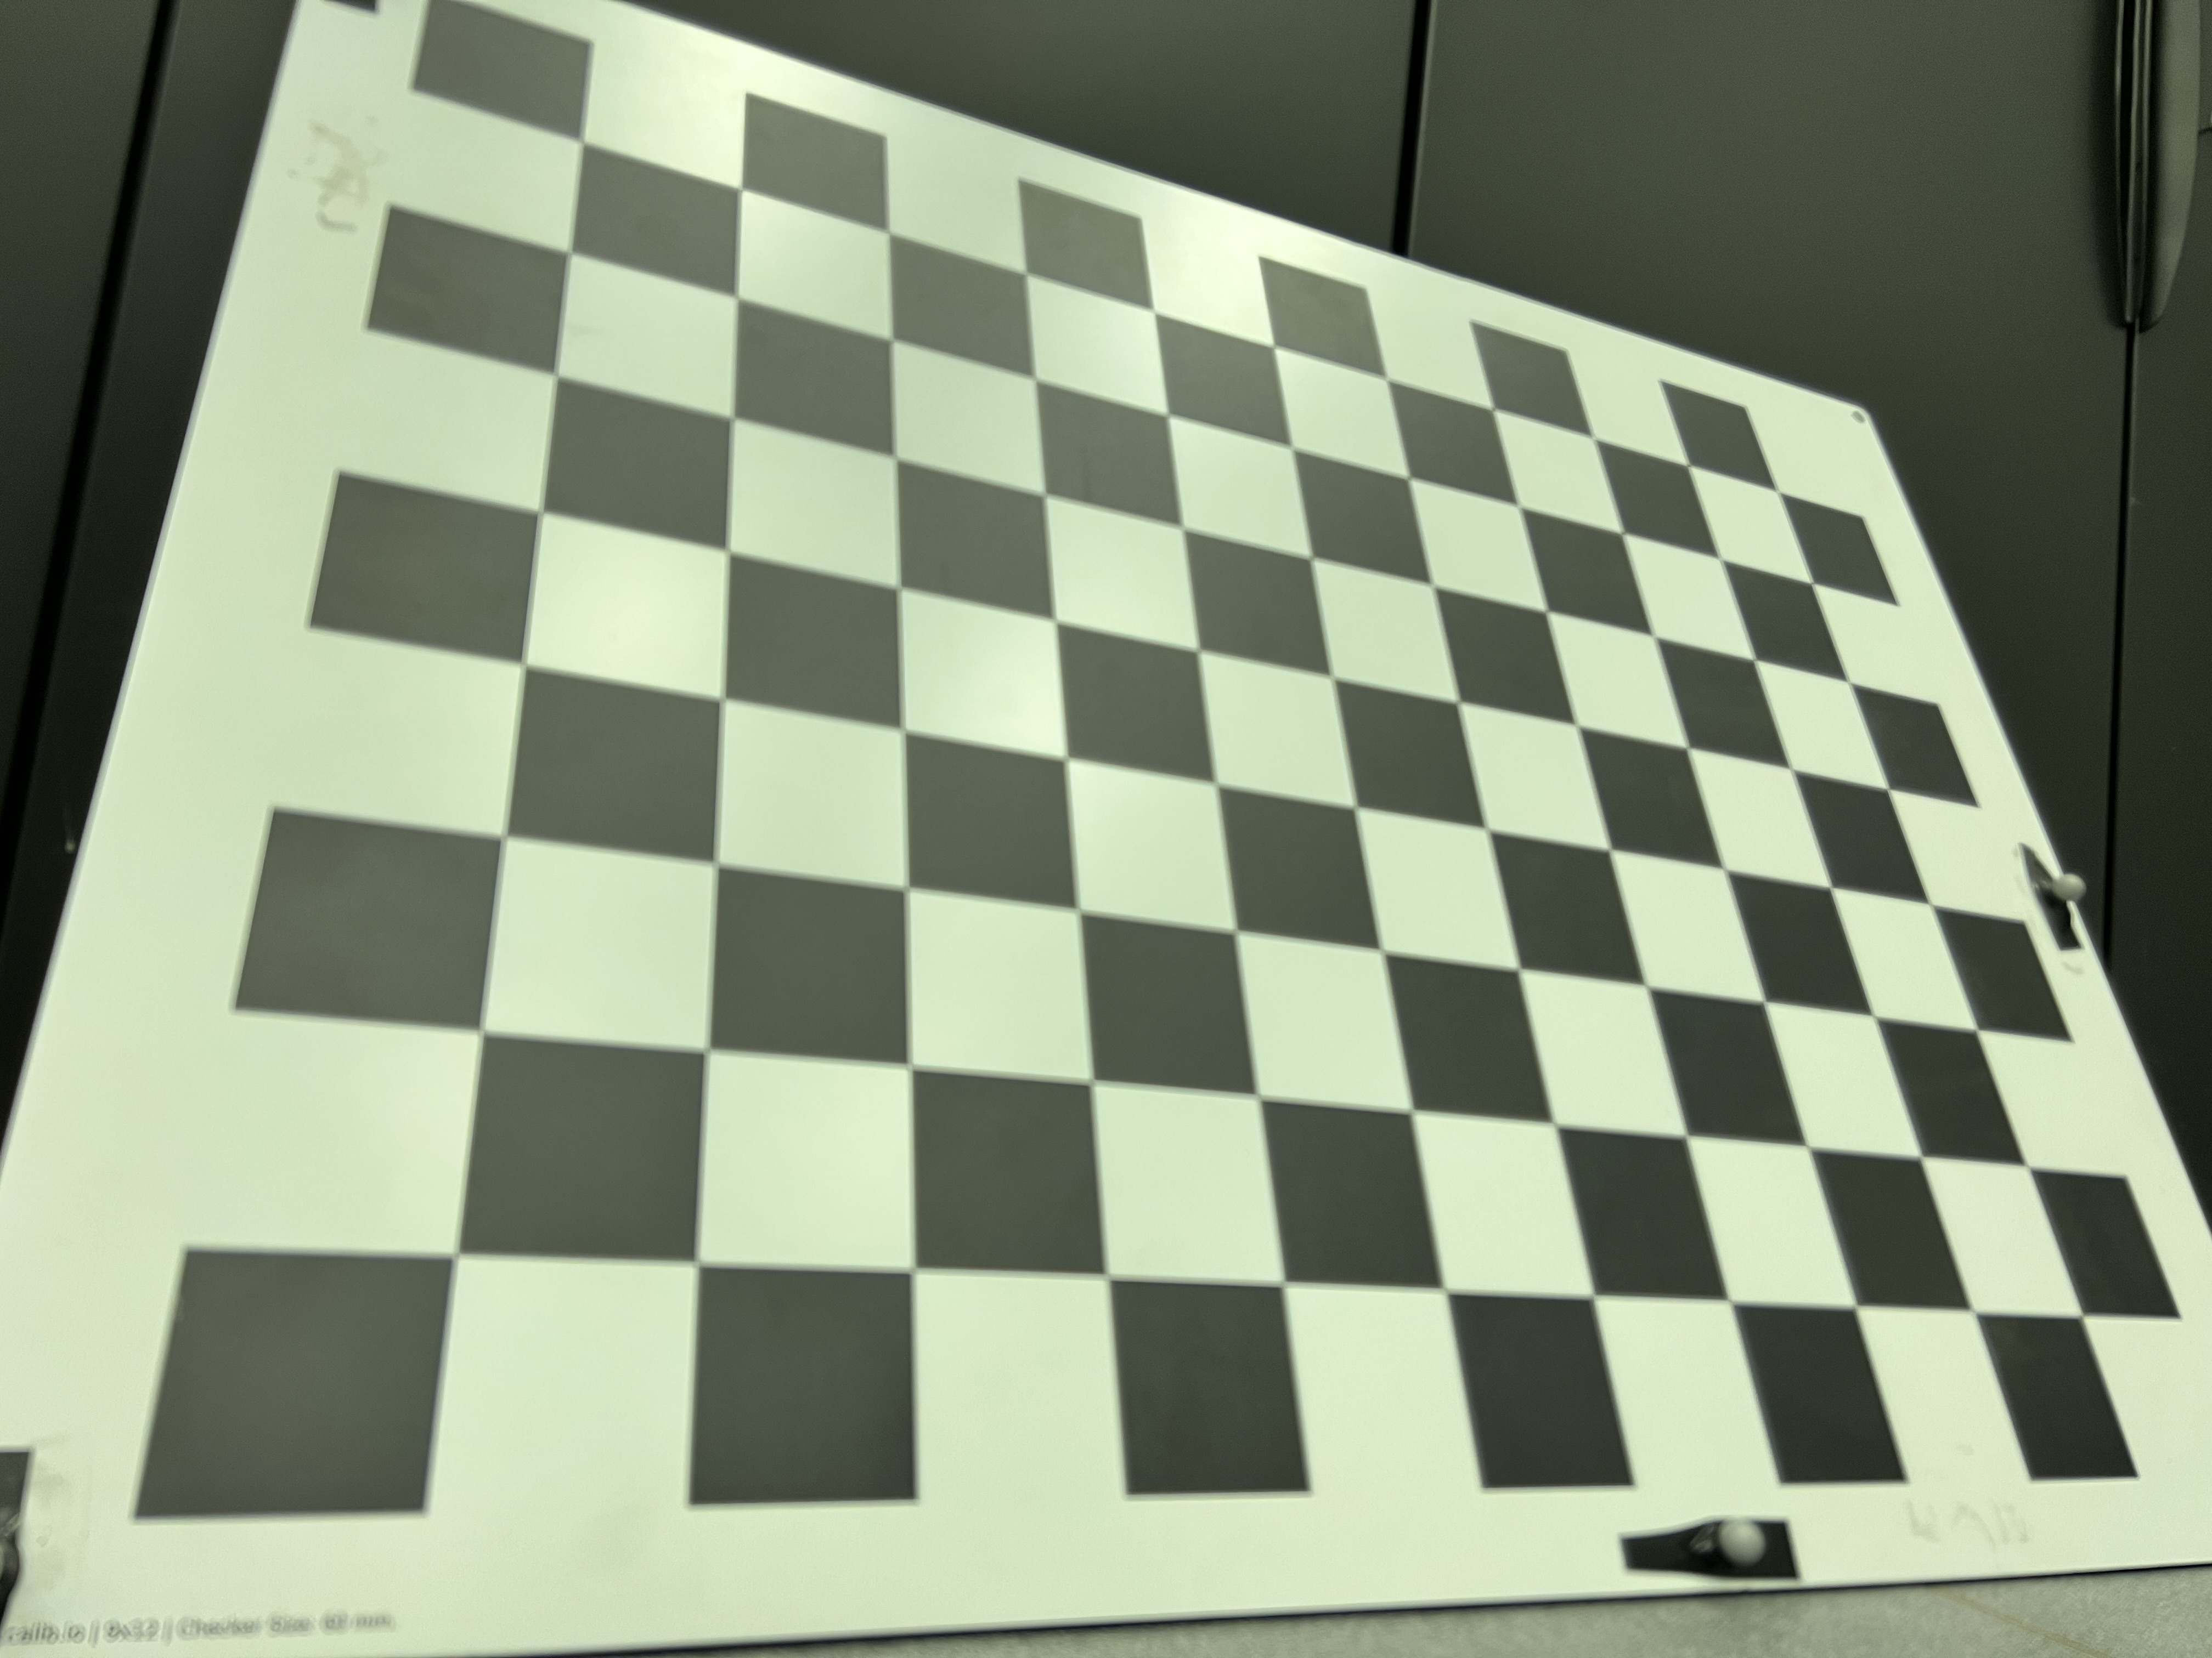
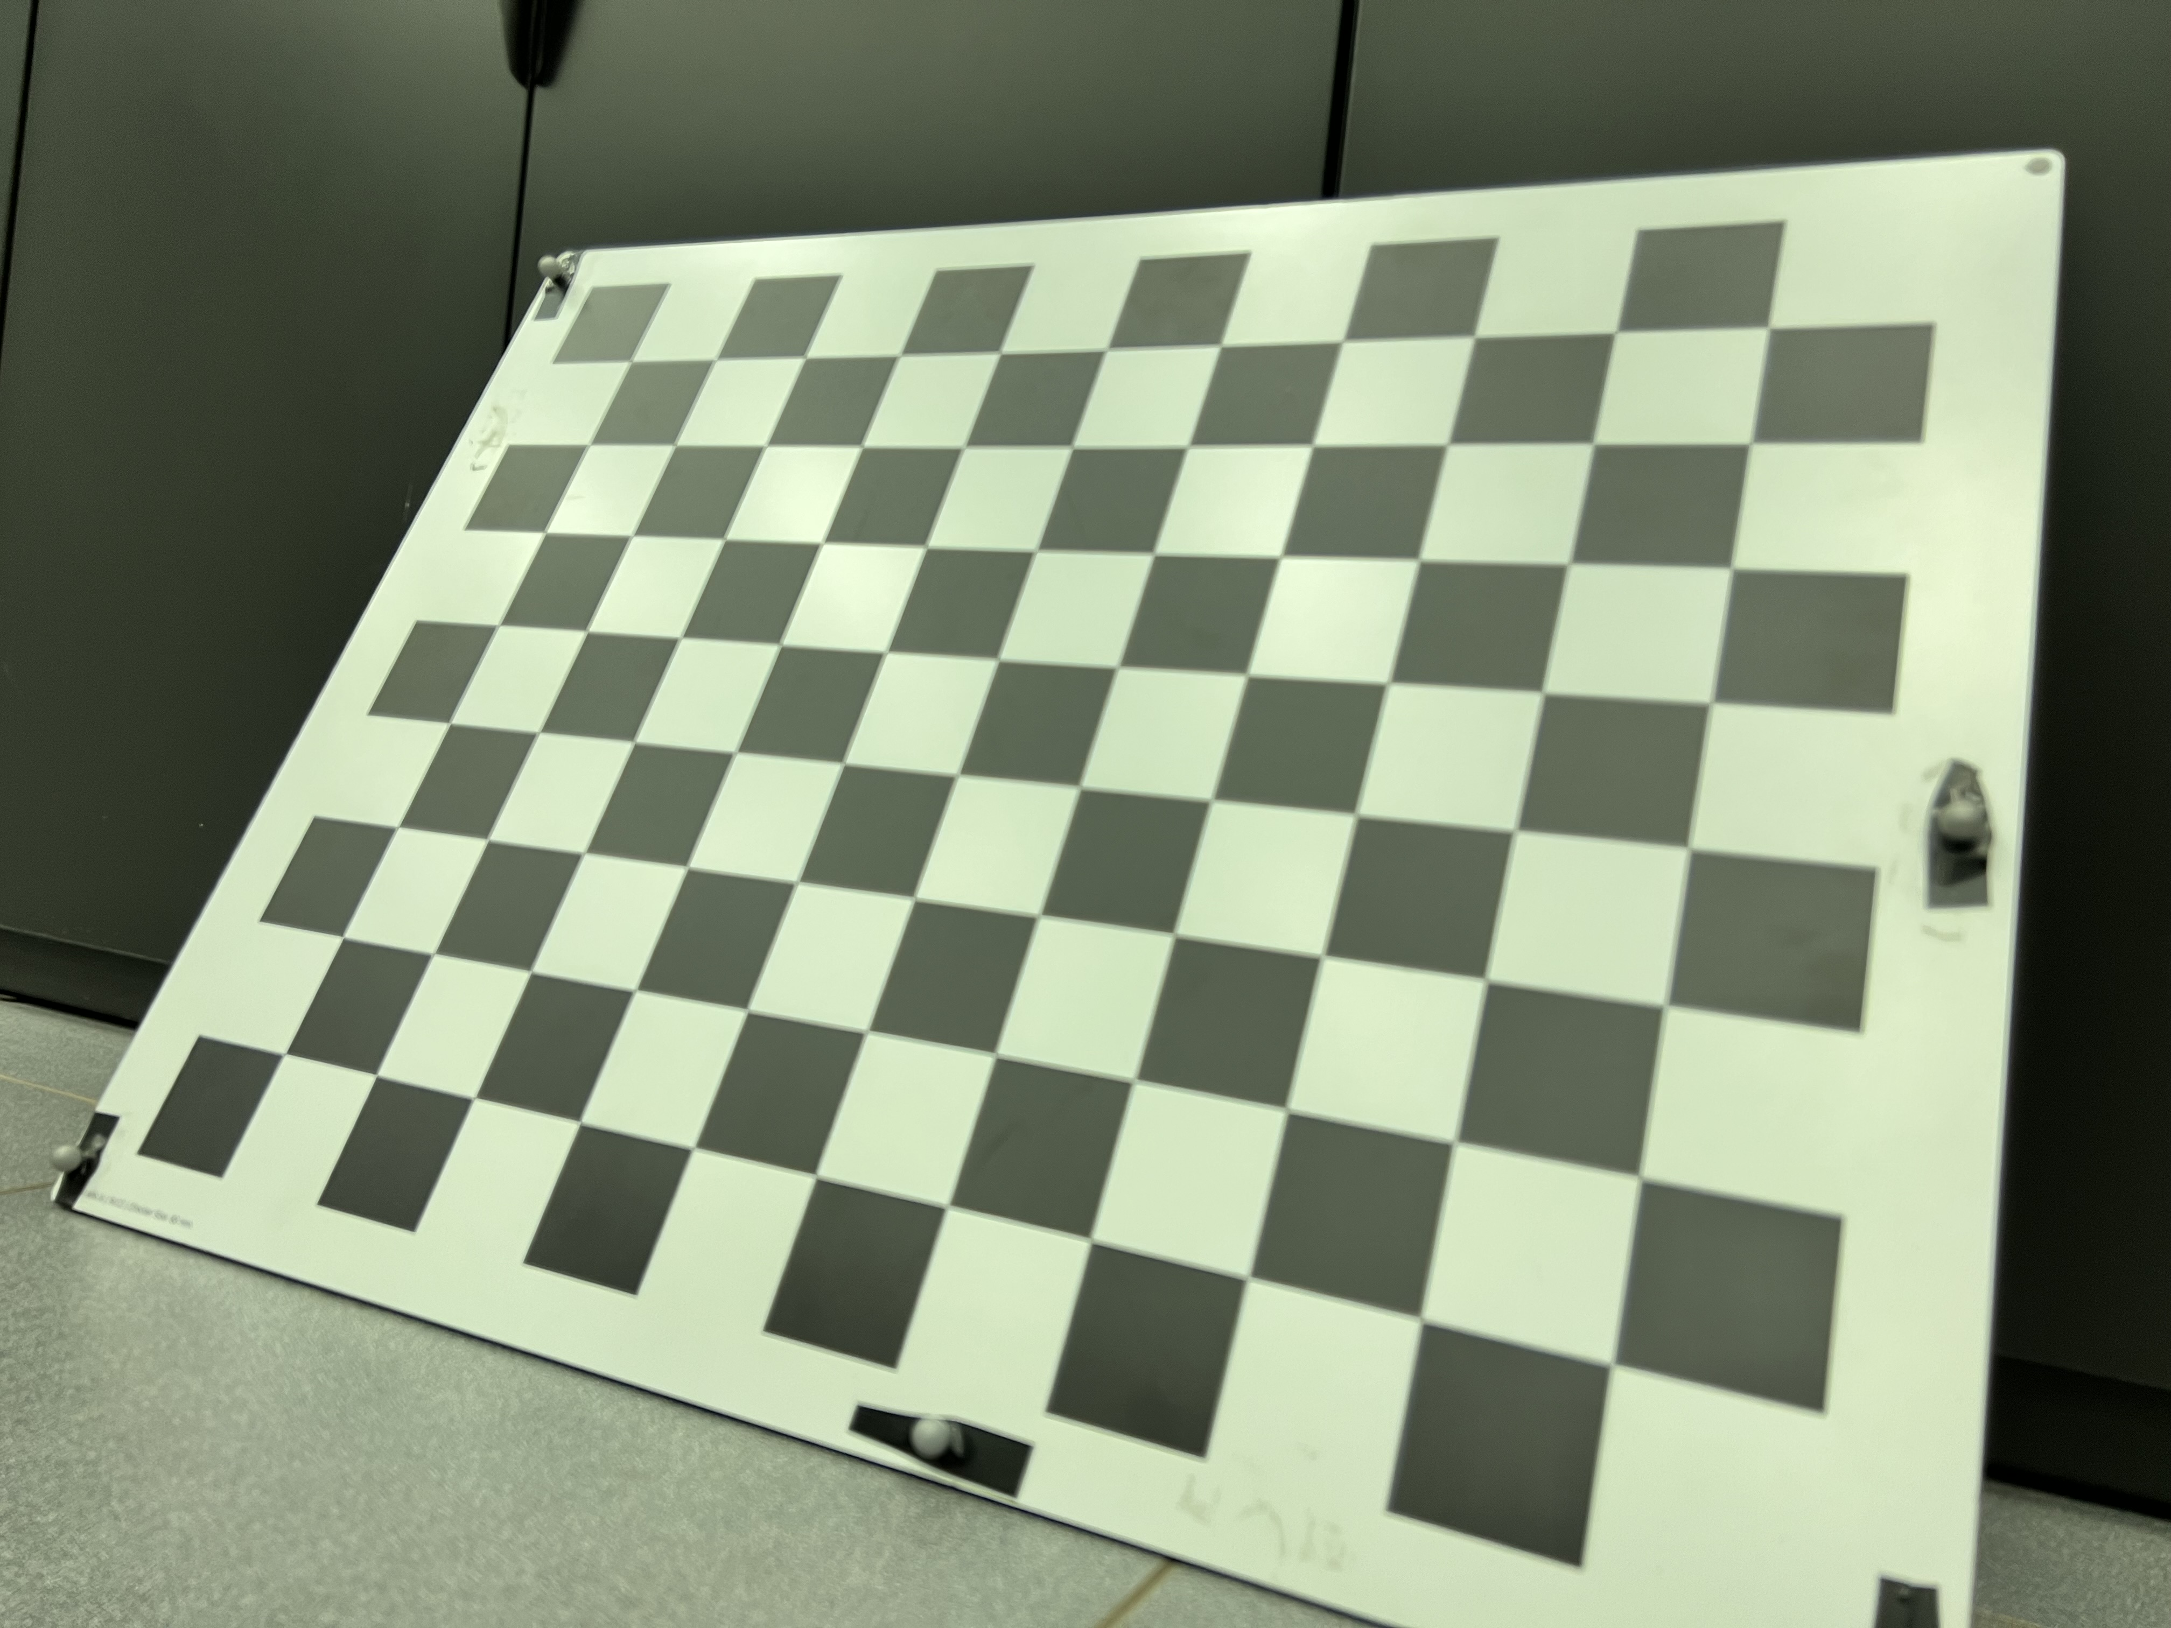
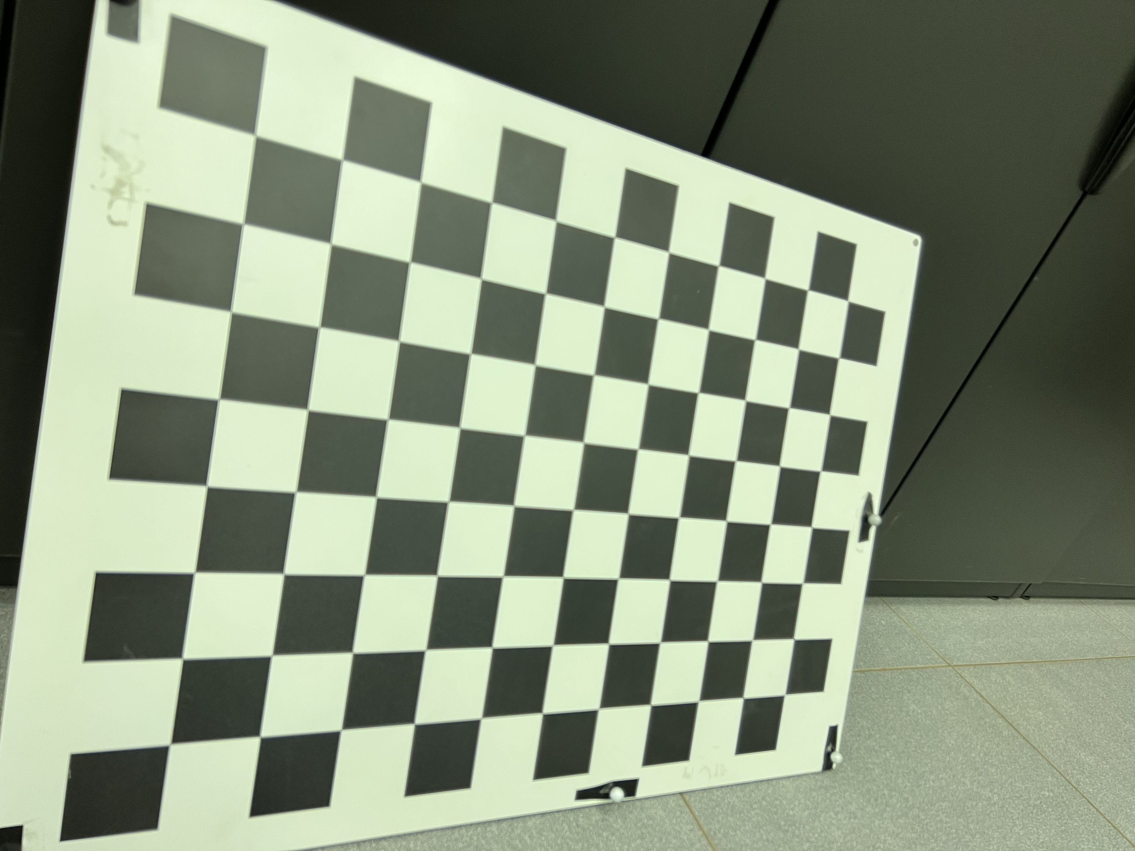
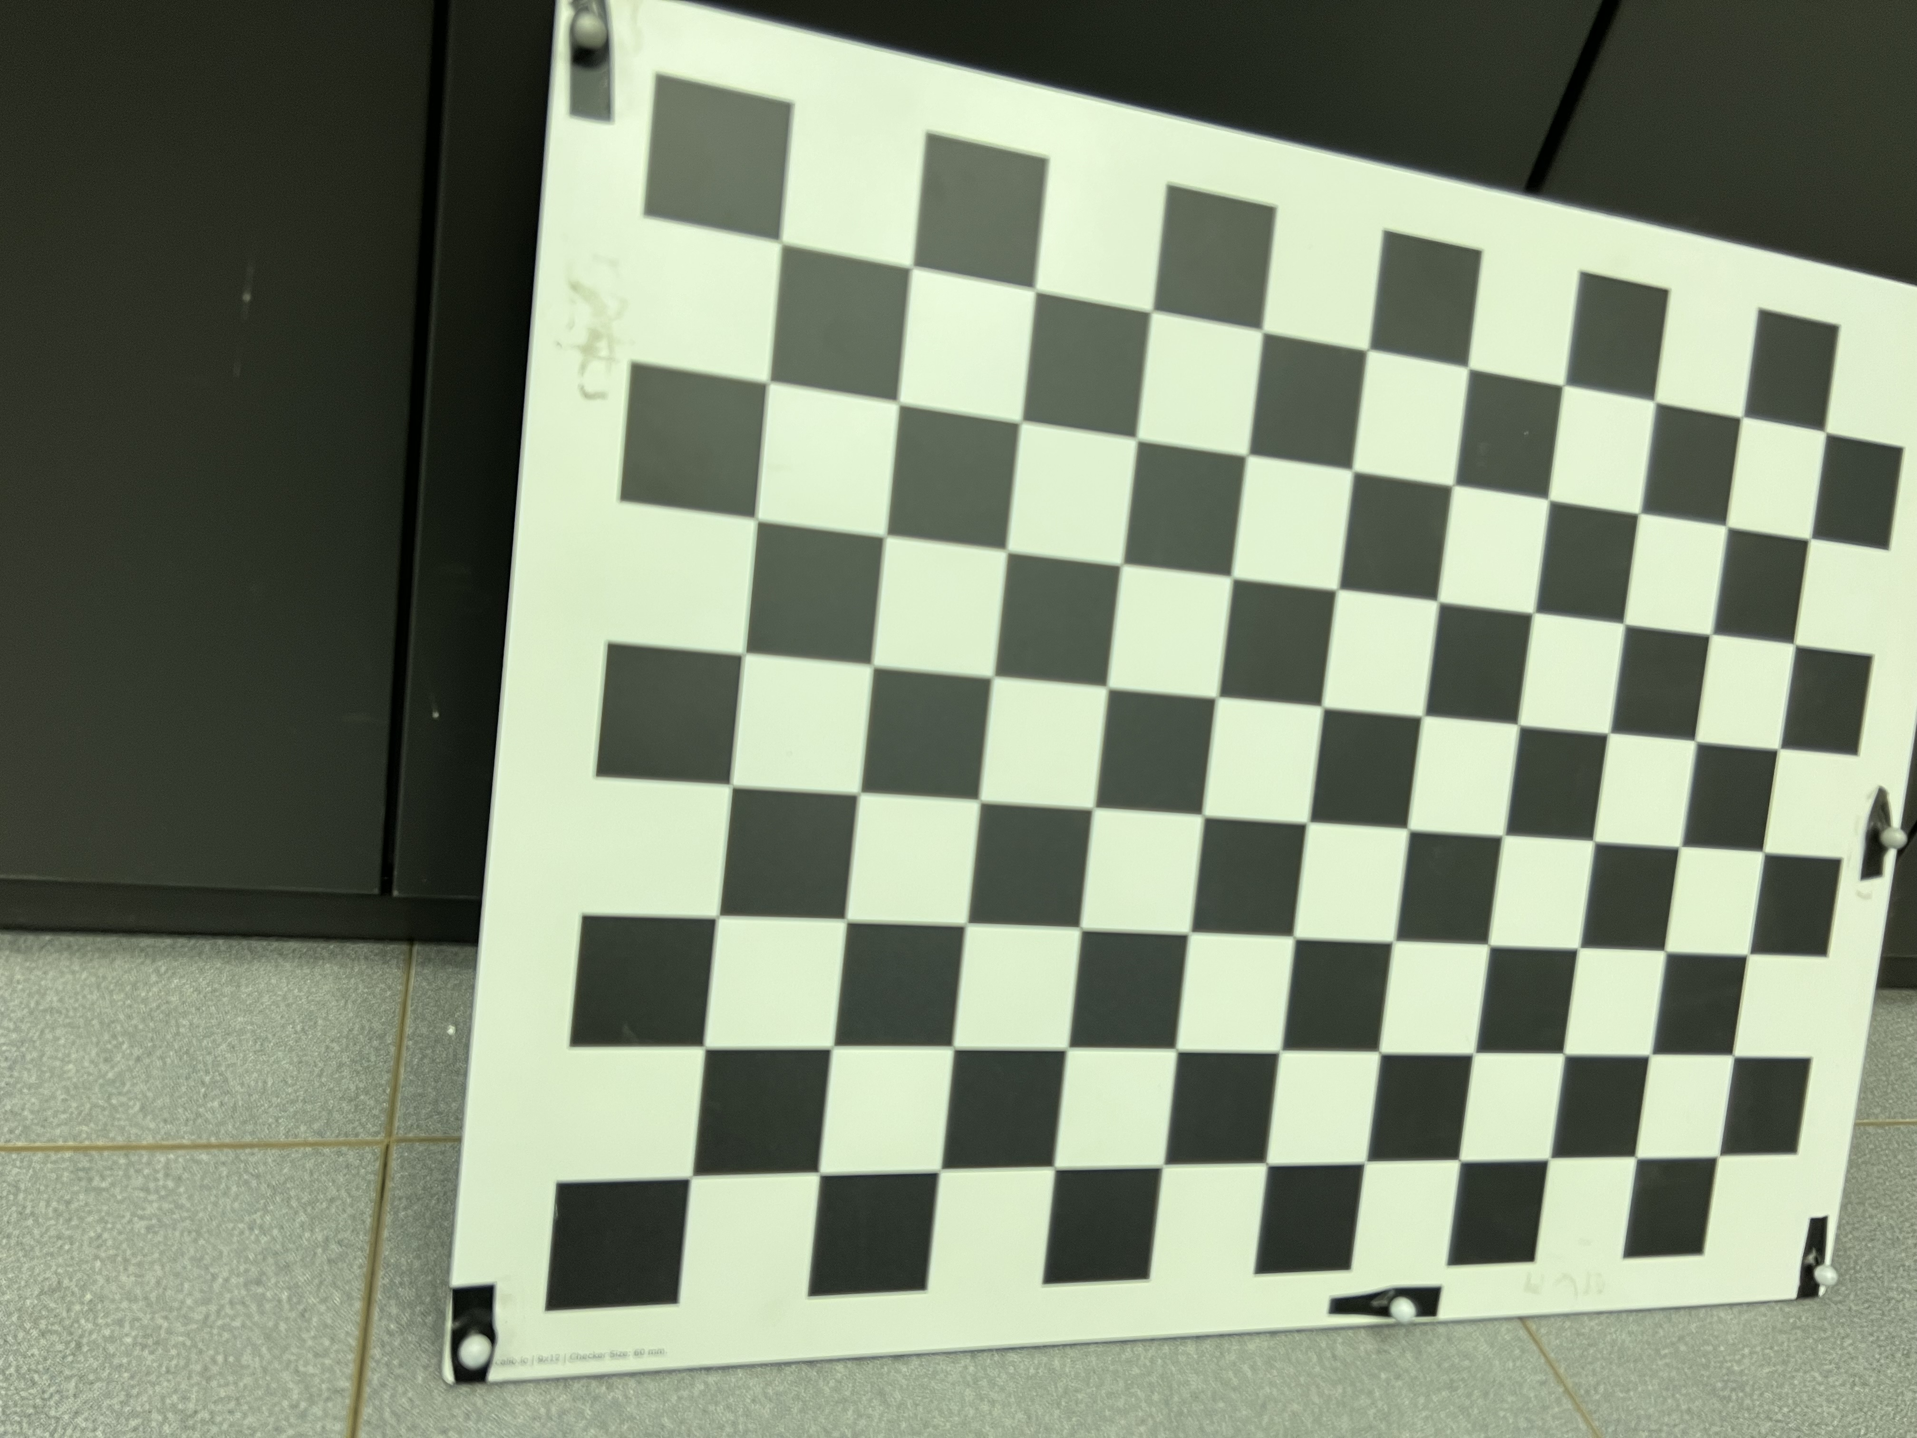
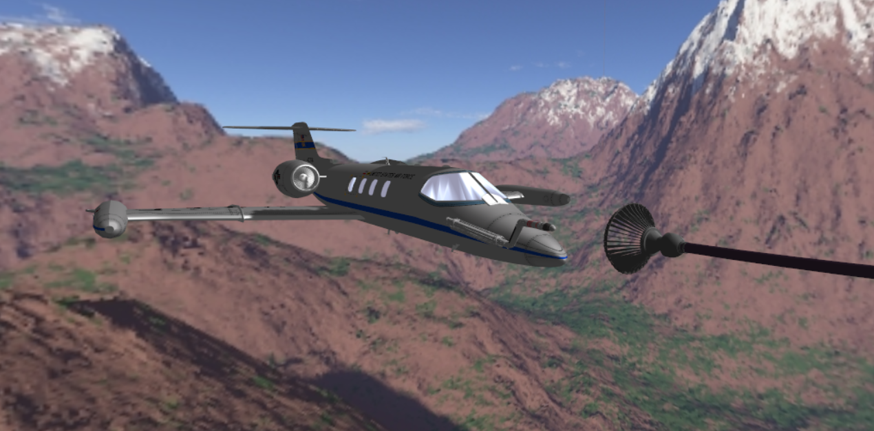
Camera
2D points
Solve
PnP
image capture
3D points
rvec
tvec
Camera Intrinsics
(from chessboard calibration)
Fiducial targets
3D points
mocap
markers
Mocap System
Project
Points
mocap
markers
motion capture
3D points
Learjet nose cone
2D points
2D points
2D points
Reprojections back into
original image
Digital Twin

